Slide 1
What Is An Exploit ?
What is an exploit ?
Program or some code that takes advantage of a security hole (i.e. a vulnerability) in an application or system, so that an attacker can use it for their benefit.
https://www.welivesecurity.com/2015/02/27/exploits-work/

Slide 2
What Is An Exploit ?
Remote exploit:
A remote exploit works over a network and exploits the security vulnerability without any prior access to the vulnerable system.
https://en.wikipedia.org/wiki/Exploit_(computer_security)

Slide 3
What Is An Exploit ?
Local exploit:
A local exploit requires prior access to the vulnerable system and usually increases the privileges of the person running the exploit past those granted by the system administrator.
https://en.wikipedia.org/wiki/Exploit_(computer_security)

Slide 4
What Is An Exploit ?
Exploit database:
The Exploit Database is a CVE compliant archive of public exploits and corresponding vulnerable software, developed for use by penetration testers and vulnerability researchers. Our aim is to serve the most
https://www.exploit-db.com/about/

Slide 5
What Is An Exploit ?
Exploit database:
…comprehensive collection of exploits gathered through direct submissions, mailing lists, as well as other public sources, and present them in a freely-available and easy-to-navigate database.
https://www.exploit-db.com/about/

Slide 6
What Is An Exploit ?
Exploit database:
The Exploit Database is a repository for exploits and proof-of-concepts rather than advisories, making it a valuable resource for those who need actionable data right away.
https://www.exploit-db.com/about/

Slide 7
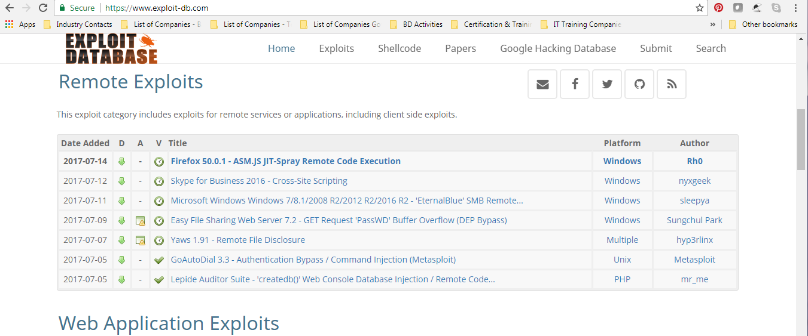
What Is An Exploit ?

Slide 8
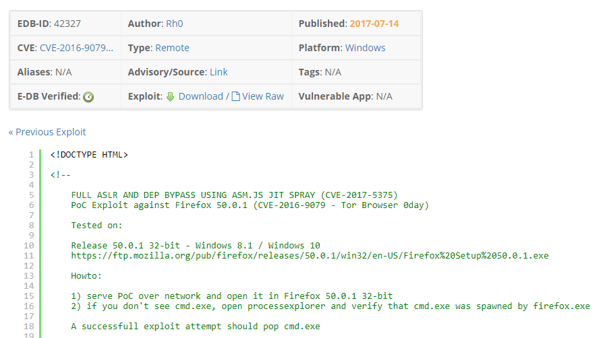
What Is An Exploit ?
SNAPSHOT OF EXPLOIT CODE

Slide 9
What Is An Exploit ?
Zero-day exploit:
A zero day vulnerability refers to a hole in software that is unknown to the vendor. This security hole is then exploited by hackers before the vendor becomes aware and hurries to fix

Slide 10
What Is An Exploit ?
Zero-day exploit:
it-this exploit is called a zero day attack.
http://www.pctools.com/security-news/zero-day-vulnerability/
END

